Slide 1
Currency Converter
Mini project

Slide 2
Index
Introduction
Program Flow
Program Explanation 1: Menu and Input
Program Explanation 2: Switch Statement
Program Explanation 3: Invalid Input Handling
Full Program
Output
Conclusion

Slide 3
Introduction
The main goal behind this project is to provide a simple and interactive tool for currency conversion. It allows users to select a conversion type and input an amount to get the equivalent amount in the target currency. The tool uses predefined exchange rates to perform the conversion. Useful for travellers, businesses, or anyone needing quick currency conversion.

Slide 4
Program Flow
Step 1: Display a menu of currency conversion options.
Step 2: Prompt the user to select a conversion option (1-10).
Step 3: Ask the user to enter the amount they want to convert.
Step 4: Perform the conversion using predefined rates based on the selection.
Step 5: Display the result of the conversion.
Step 6: Handle invalid input.

Slide 5
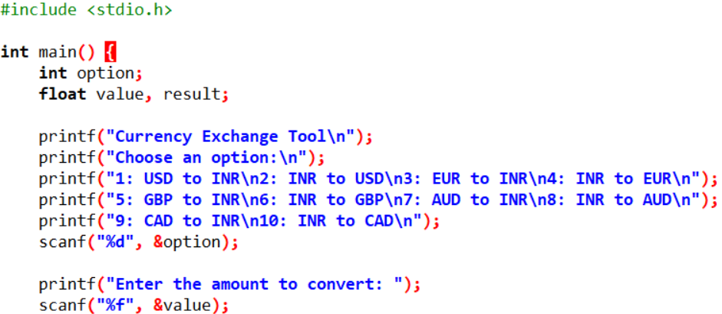
Program Explanation 1 : Menu and Input
The program first displays the conversion options.
The user selects an option (1-10) for currency conversion.
The program then asks for the amount to be converted, which is stored in the variable value

Slide 6
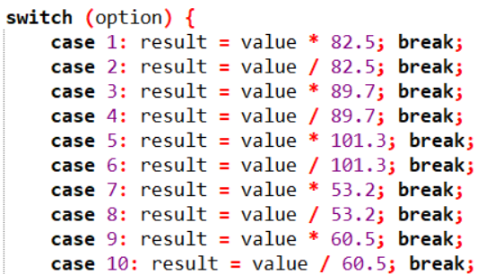
Program Explanation 2: Switch Statement
Based on the selected option, the program uses a switch statement to determine the appropriate conversion factor.
For each case (e.g., case 1 for USD to INR), the program multiplies or divides the value by the respective conversion rate.

Slide 7

Program Explanation 3: Invalid Input Handling
If the user selects an invalid option (not between 1-10), the program prints an error message and terminates.
This ensures that only valid inputs are processed, avoiding unexpected behaviour.

Slide 8
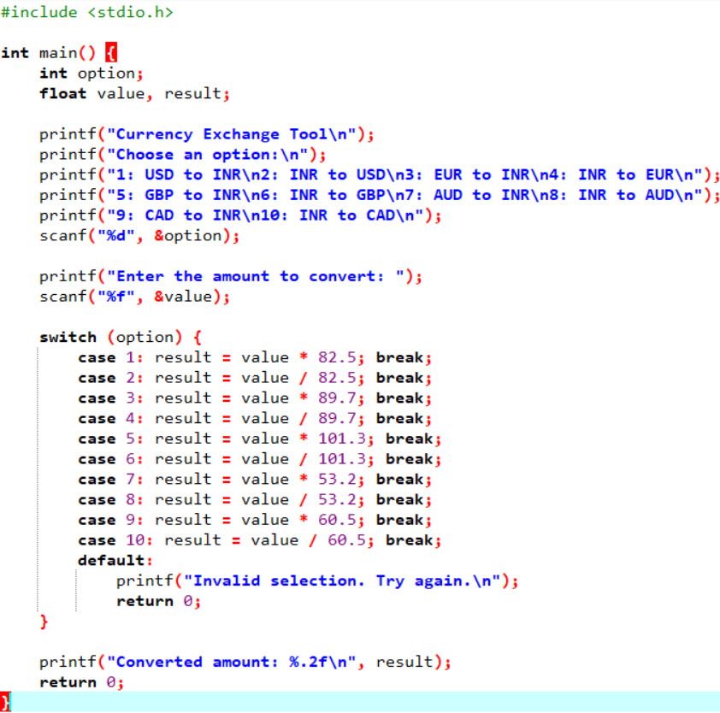
Full Program

Slide 9
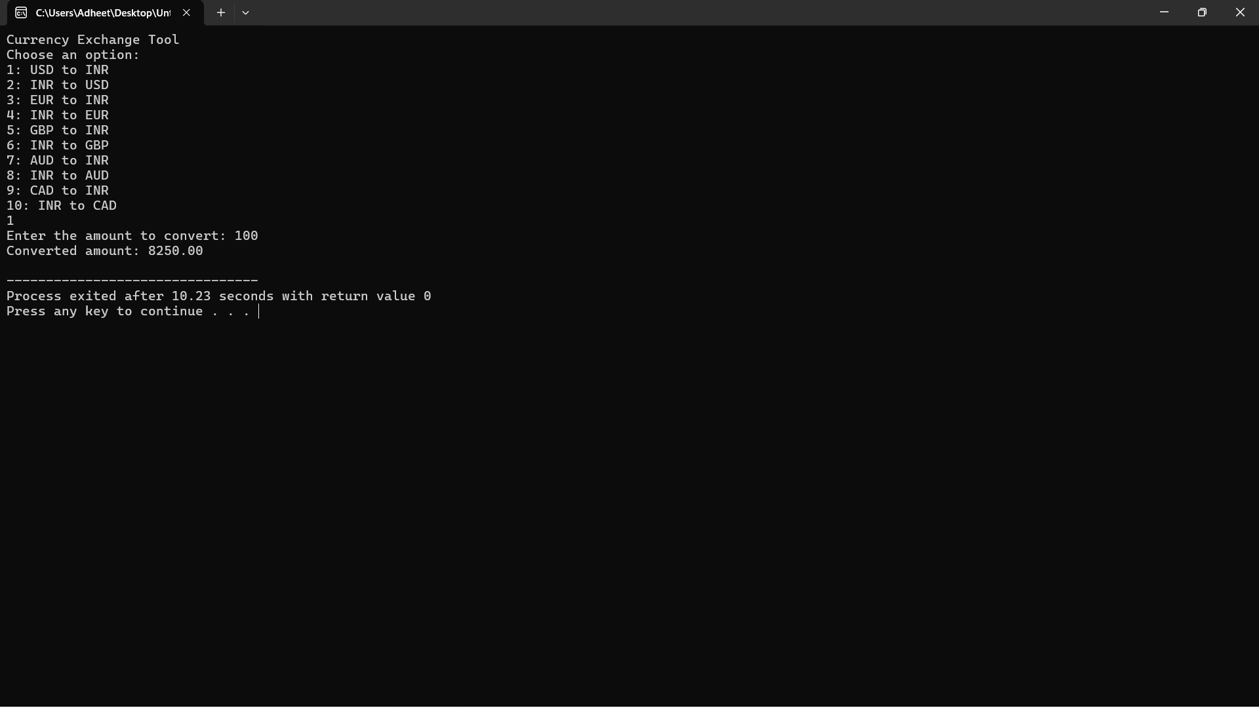
Output

Slide 10
Conclusion
This program is a simple demonstration of how currency conversion can be implemented in C.
It allows the user to quickly and easily convert currencies using predefined rates.
Future enhancements can make it more robust and user-friendly by integrating live data and improving error handling.

Slide 11
Presented by
Adheet Suraj
Anish Sahoo
Manan Detroja
Manoj Patel
Shrish Kulkarni

